Slide 1
Python for Beginners
Part 3

Slide 2
Any Questions from Part 1 & 2?
Part 1 – input & output, # comments
Part 2
Escape Sequences \n \t \a \* \\
Triple Quoted Strings “””
Variables
Math + - * /
String Concatenation using + and ,
Formatting Numbers
format(number, “.2f”)

Slide 3
What We Will Learn in This Lesson (Part 3)
import statement
random numbers
dot notation
Branching
Writing Simple Game Programs
Loops

Slide 4

Unpredictability Makes Games Fun
Unpredictable …
Means you don’t know what will happen
If you want to write a game program
how do you make it unpredictable?

Slide 5
Random Numbers
Series of Numbers that when you look at them it is
impossible to predict future values
based on past or present ones.
NOT Random -> 2, 4, 6, 8, 10, 12, 14
Random -> 19, 879, 34, 44, 234

Slide 6
Random Numbers on a Computer
Computers use formulas to create Random Numbers
Programmers create functions that use these formulas
A function that creates a Random Number is called a …
Random Number Generator

Slide 7
Is it really a Random Number?
If Computers use formulas to create Random Numbers then…
Can it really be a Random Number?

Slide 8
Is it really a Random Number?
No.
It is actually a … Pseudo Random Number
Real Random Numbers are hard to generate.

Slide 9
How do we get Random Numbers in Python?
At the top of the program file!
import random

Slide 10

Import Statement
Modules are python files that have code that is already written.
Don’t reinvent the Wheel!
Import statements let us use these modules in our programs.

Slide 11
Random Functions
random.randint(first, last)
Generates an integer between first & last values
Example:
die1 = random.randint(1, 6)
Generates a number between 1 & 6
1, 2, 3, 4, 5, or 6
What type is die1?

Slide 12
Dot Notation
random.randint()
This Dot means…
The function randint() BELONGS to the module random

Slide 13
Random Functions
random.randrange(value)
Generates an integer between zero & value
Example:
die2 = random.randrange(5)
Generates a number between 0 & 5
0, 1, 2, 3, 4, 5

Slide 14
Random Functions
How do we get an integer between 1 & 6?
die2 = random.randrange(5) + 1
Creates an integer from 0-5 then adds 1

Slide 15

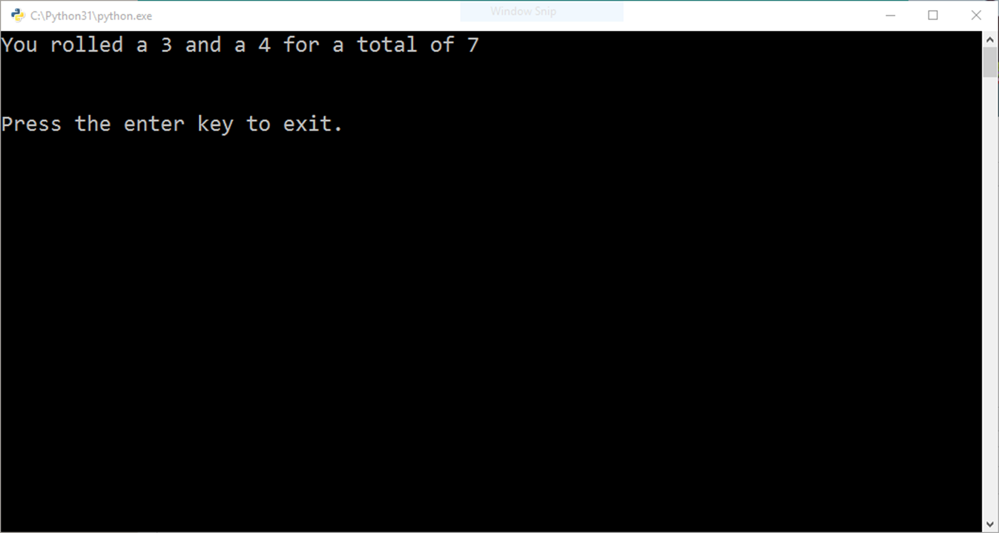
Craps Roller Program

Slide 16
Let’s Code This Program
Open a New File
Add Comments at Top
Import the Random Module
# Your Name
# Craps Roller
# Demonstrates random number generation
#import the random module
import random

Slide 17
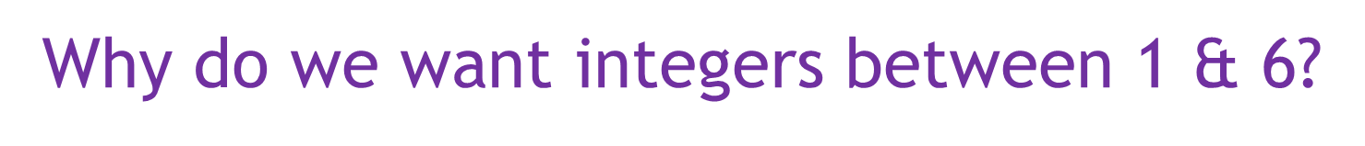
Let’s Generate 2 Random Numbers between 1 & 6
Using the randint() and randrange() functions
# generate random numbers 1 – 6
# these are two different ways to do the same thing
die1 = random.randint(1, 6) #Generates a number between 1 and 6
die2 = random.randrange(6) + 1 # Generates a number between 0 and 5
# then adds 1
# add the value of the two dice together
total = die1 + die2

Slide 18
Let’s Generate 2 Random Numbers between 1 & 6
Using the randint() and randrange() functions
# generate random numbers 1 – 6
# these are two different ways to do the same thing
die1 = random.randint(1, 6) #Generates a number between 1 and 6
die2 = random.randrange(6) + 1 # Generates a number between 0 and 5
# then adds 1
# add the value of the two dice together (math is fun)
total = die1 + die2
Which random function is better?

Slide 19
Let’s Print out the Results
# output result to the player
print("You rolled a", die1, "and a", die2, "for a total of", total)
# pause for player input before exiting console window
input("\n\nPress the enter key to exit.")
Save & Run Your Program After you finish typing it all in!

Slide 20
Craps Roller Program
Your results may differ! ☺

Slide 21

Branching
Making a decision to
take one path or another.

Slide 22

If some condition
Conditions are True or False

Slide 23
Conditions are Created by
Comparing Values
if password == “secret”
Comparison Operator
When is the value True?
When is the value False?

Slide 24
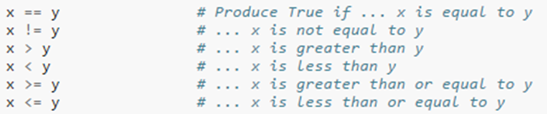
Comparison Operators

Slide 25
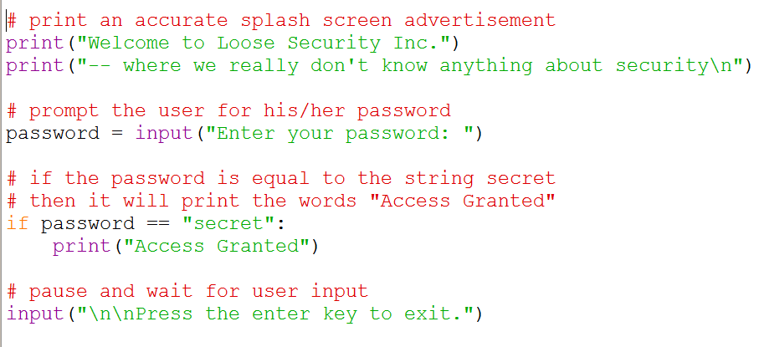
Let’s Try An Example
1. Type this in a File … the comments are optional if you need to save time.
Colon :
Indented!
2. Let’s Run this Program two times to See What Happens!
On the first try, Enter the password “secret” (no quotes)
On the second try, Enter the password “truth” (no quotes)

Slide 26
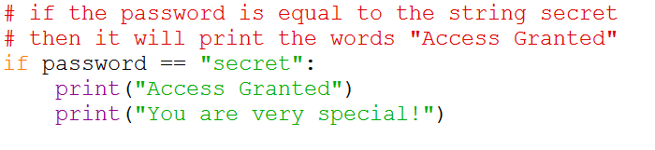
Block Indentation
Do you need multiple instructions to handle your choice?
Try changing your program to print two lines if the password is “secret”
Indent the SAME Amount!
Grouped into a Block
Tabs or Spaces? Just be consistent

Slide 27
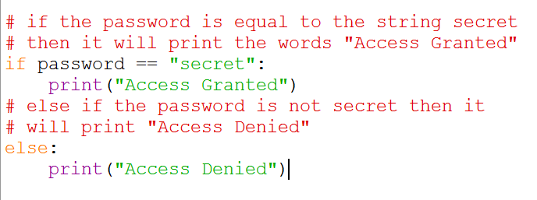
Let’s Use An else clause
1. Change your program to use an else clause in the if statement.
2. Let’s Run this Program two times to See What Happens!
On the first try, Enter the password “secret” (no quotes)
On the second try, Enter the password “truth” (no quotes)

Slide 28
Got Lots of Choices?
Then use the
elif
Clause
elif means ‘else if’

Slide 29
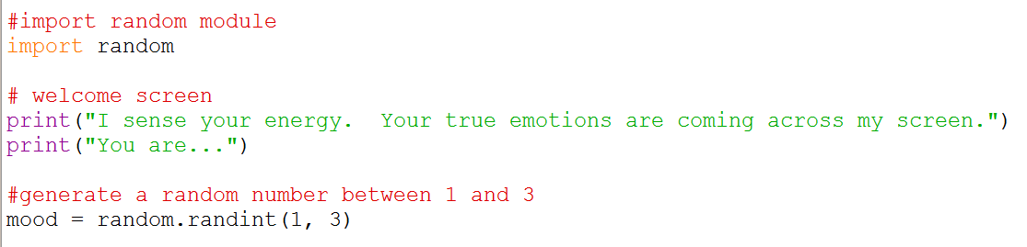
Let’s Type In Another Example
1. Open a New File and start typing the following… (comments are optional)

Slide 30
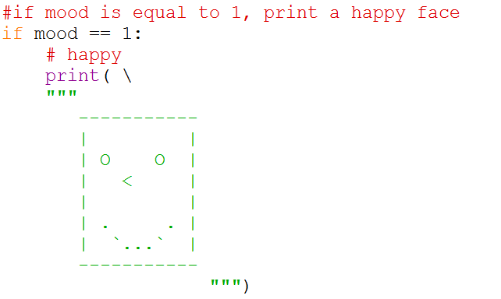
Let’s Add An If Statement
2. Add the following to your file … watch out for indenting, colons, and triple quotes!

Slide 31
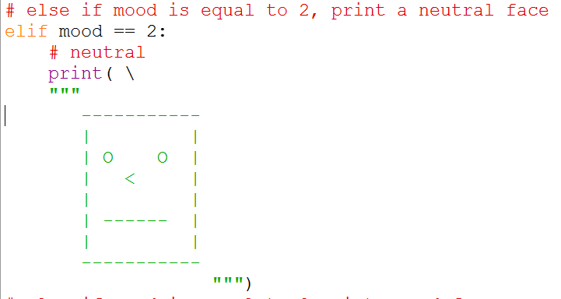
Let’s Add an elif clause
3. Add the following to your file … watch out for indenting, colons, and triple quotes!

Slide 32
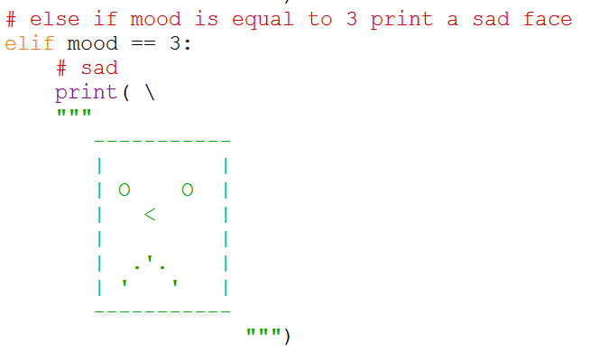
Let’s Add Another elif Clause
4. Add the following to your file … watch out for indenting, colons, and triple quotes!

Slide 33
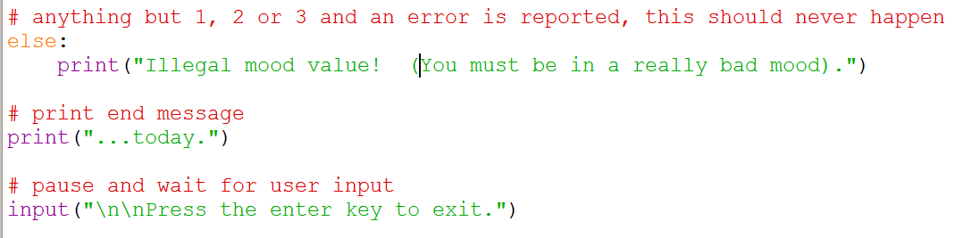
Let’s Finish Up This Example
5. Add the following to your file …
6. Now Let’s Run this Program to See What Happens!

Slide 34

Let’s See What You Learned!

Slide 35

The Magic 8 Ball
Ask a question out loud.
Shake the Magic 8 Ball.
Turn it over and look a the message.
20 Possible Messages
https://en.wikipedia.org/wiki/Magic_8-Ball
It is certain
It is decidedly so
Without a doubt
Yes, definitely
You may rely on it
As I see it, yes
Most likely
Outlook good
Yes
Signs point to yes
Reply hazy try again
Ask again later
Better not tell you now
Cannot predict now
Concentrate and ask again
Don't count on it
My reply is no
My sources say no
Outlook not so good
Very doubtful
Ten of the possible answers are Positive, five are Negative, and five are Neutral.

Slide 36
The Magic 8 Ball Program
Open a New File.
Add a comment with your name so everyone knows who wrote this program!
Use the input() function to ask the user to type their question for the magic 8 ball. We don’t need to save it but its traditional to ask.
Use one of the random() functions to generate a random number between 1 and the number of possible messages. Try to use at least 3 so you can use an elif clause.
Use if/elif/else statements to display at least 3 different messages.
(Optional) Use ASCII art to spice it up!
Use the input() function to pause the output of the program and prompt the user to press the enter key.
Save & Run Your Program. Fix any bugs! That’s how real programmers like you do it!

Slide 37

Working Break Time
Write your own Magic Eight Ball Program!

Slide 38

WARNING!
Code Solution
Follows
Don’t Peek
If You Don’t Need to!

Slide 39
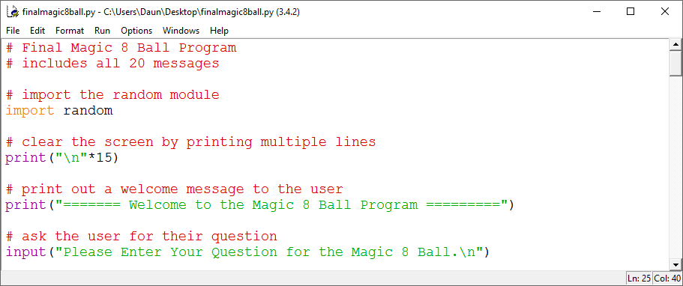
The Magic 8 Ball Program

Slide 40
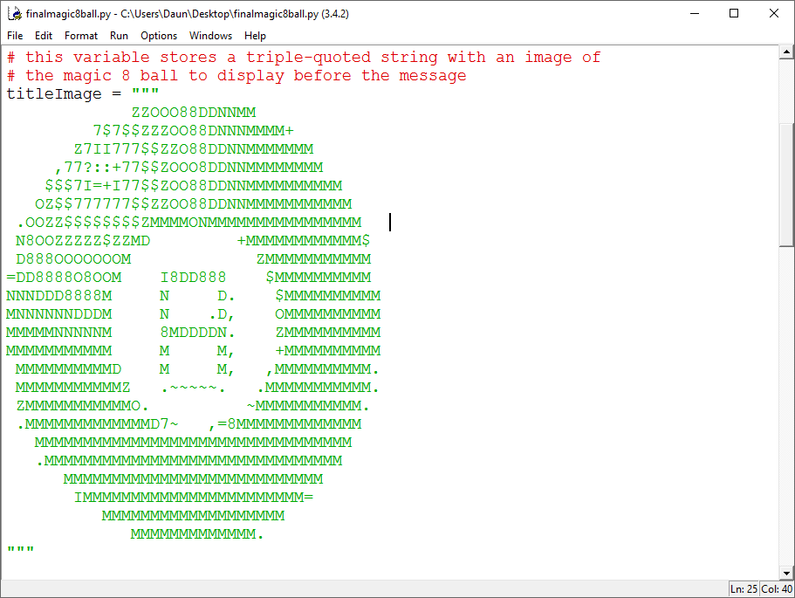
The Magic 8 Ball Program

Slide 41
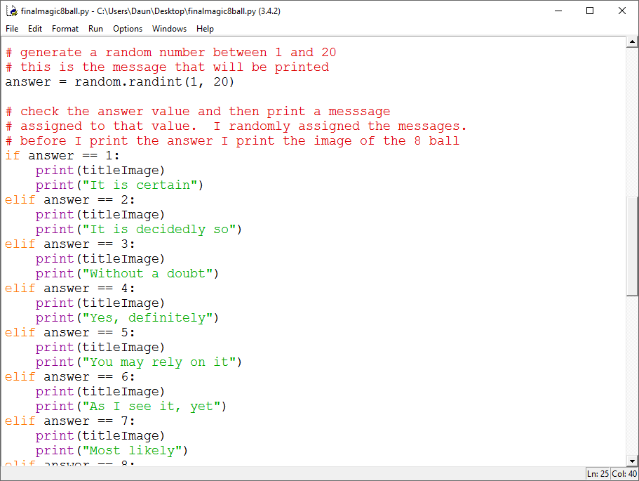
The Magic 8 Ball Program

Slide 42
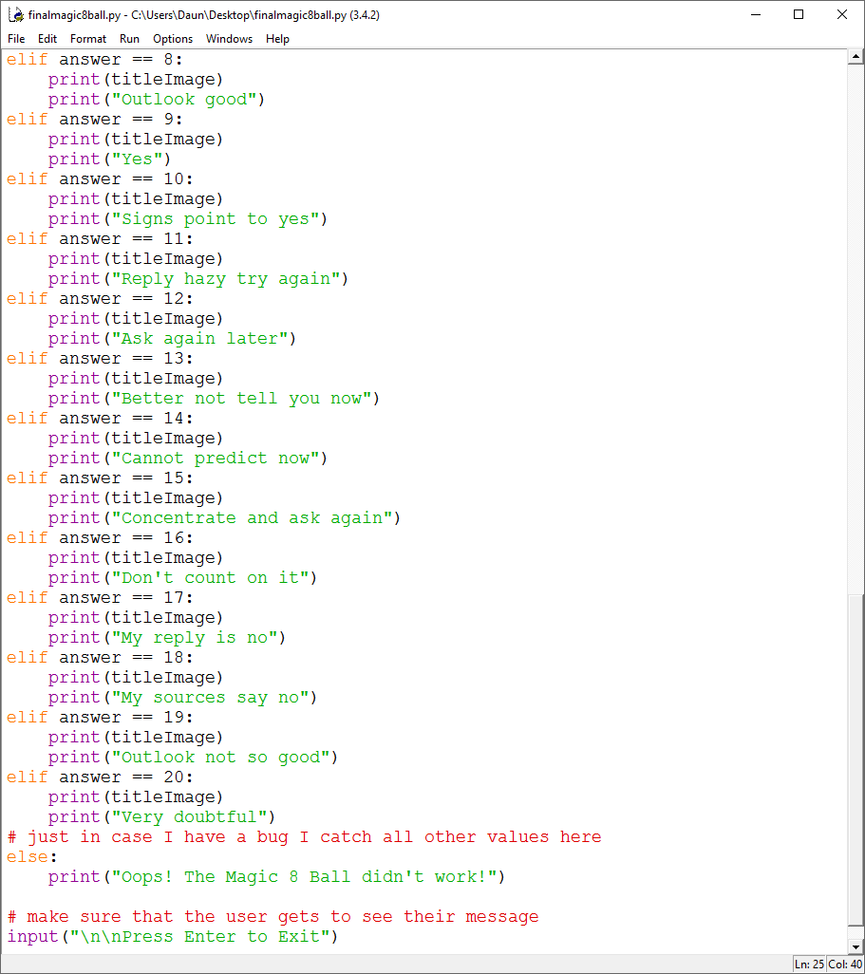
The Magic 8 Ball Program

Slide 43
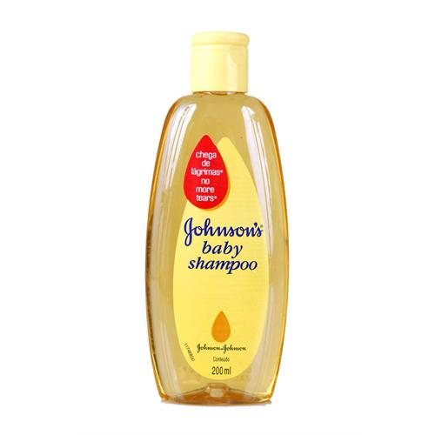
LOOPS
Loops are everywhere!
Repeat an action
Until a condition is true
Lather. Rinse. Repeat.

Slide 44

While LOOPS
Looks similar to an if statement.

Slide 45

Sentry Variable
response is SENTRY variable
Guards your loop.
Decides when the loop ends.

Slide 46
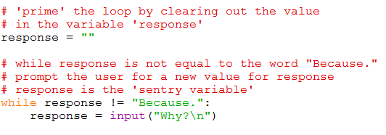

How to determine your sentry variable
Know what your stopping
condition is!

Slide 47
Keeps going while TRUE
Stops when FALSE

Slide 48
Setting your sentry variable
Usually Initialize Sentry Variable before using.

Slide 49
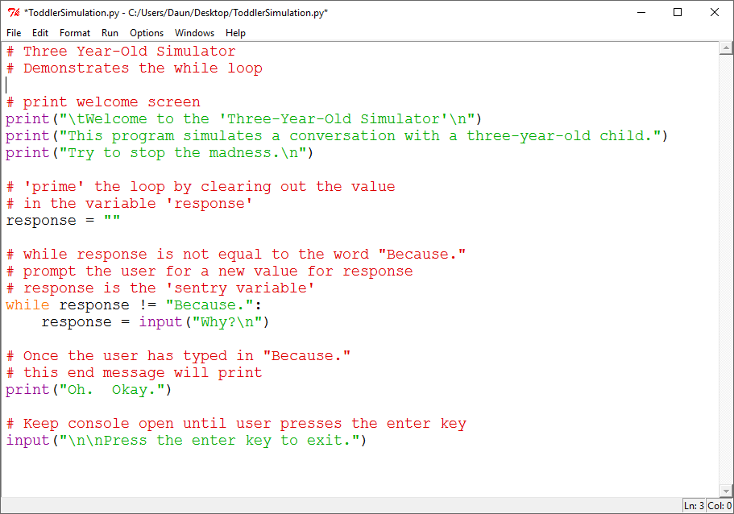

Slide 50
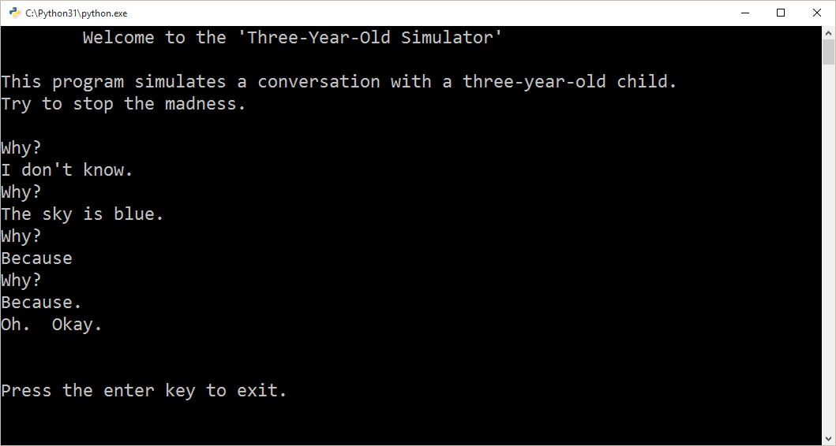

Slide 51
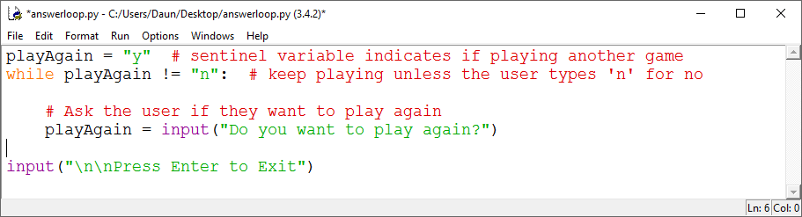
A Play-Again Loop
Try Typing this Code in A New File and Seeing What it Does!
Comments are optional to save time!

Slide 52
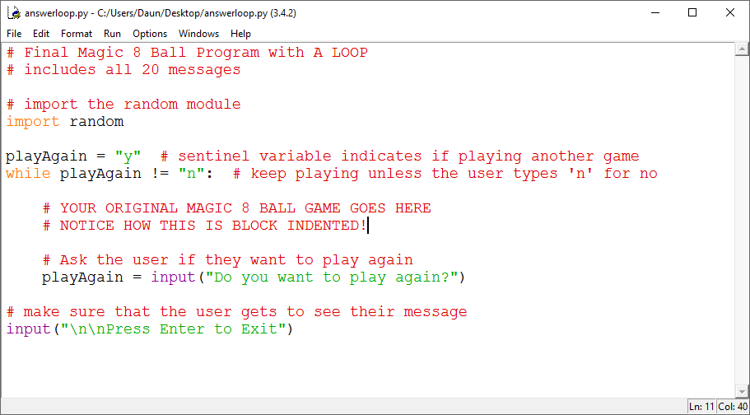
A Play-Again Loop
How Would you Add a Loop to the Magic 8 Ball Program?

Slide 53
Working Break Time
ADD A LOOP to your Magic Eight Ball Program!
Use the Play-Again Loop Example to help you.

Slide 54
Working Break Time
If You Have Time…
Can You Add a Loop to one of the other Examples?

Slide 55
Any Questions from Part 1 & 2?
Part 1 – input & output, # comments
Part 2
Escape Sequences \n \t \a \* \\
Triple Quoted Strings “””
Variables
Math + - * /
String Concatenation using + and ,
Formatting Numbers
format(number, “.2f”)

Slide 56
What We Will Learn in This Lesson (Part 3)
import statement
random numbers
dot notation
Branching
Writing Simple Game Programs
Loops

Slide 57
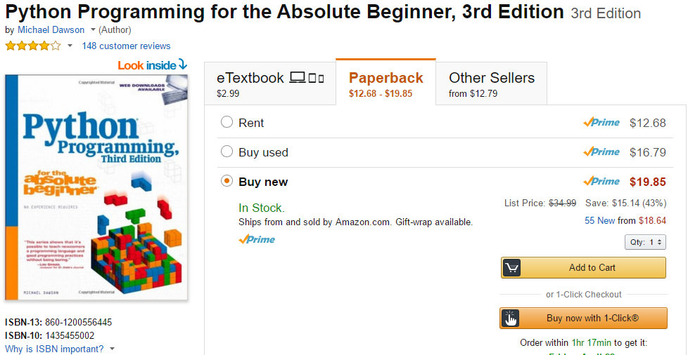
Recommended Resources
This is the Textbook that I used for this course.

Slide 58
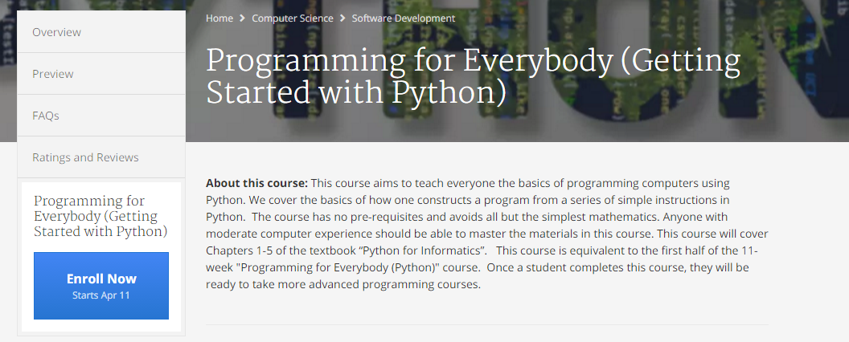
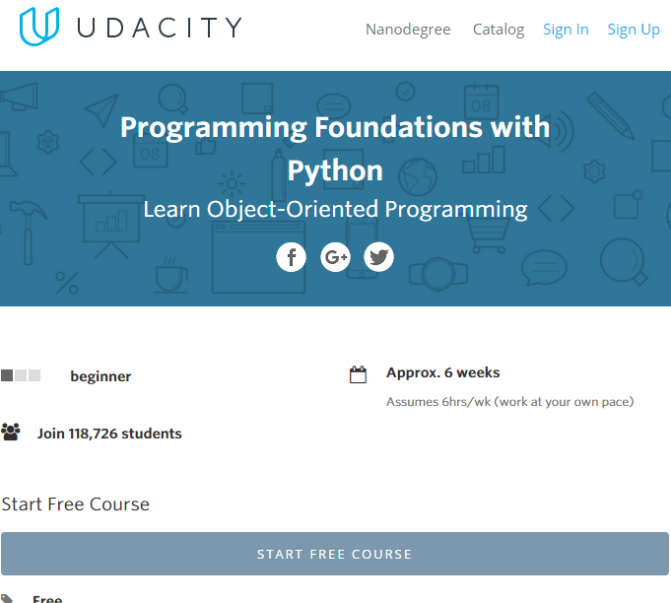
Recommended Resources
https://www.python.org/about/gettingstarted/
https://wiki.python.org/moin/BeginnersGuide
https://www.coursera.org/learn/python
https://www.udacity.com/course/programming-foundations-with-python--ud036

Slide 59
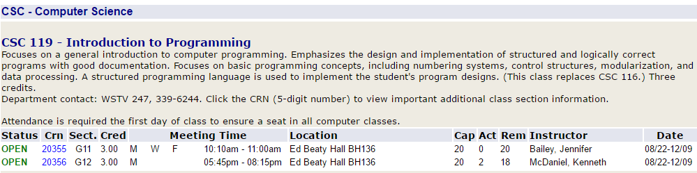
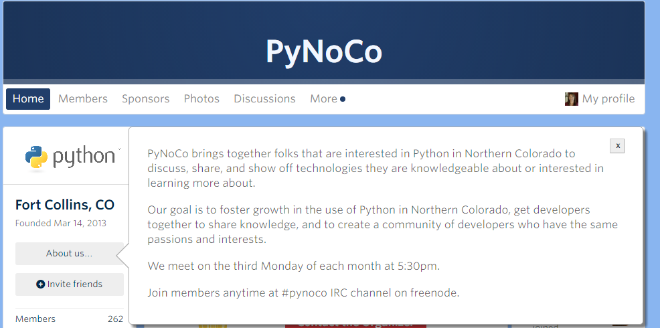
Recommended Resources
AIMS Community College – CSC 119
http://www.meetup.com/PyNoCo/

Slide 60
Recommended Resources
Google “Python Tutorials”

Slide 61


Thank You for Attending!

